Slide 1
SPIRAL MODEL
PRESENTED BY:
Radhika
Afreen
Pooja
Asfiya
Eesha

Slide 2
Introduction
Spiral model is one of the most important Software Development Life Cycle models, which provides support for Risk Handling. In its diagrammatic representation, it looks like a spiral with many loops.
The exact number of loops of the spiral is unknown and can vary from project to project. Each loop of the spiral is called a Phase of the software development process.
The exact number of phases needed to develop the product can be varied by the project manager depending upon the project risks. As the project manager dynamically determines the number of phases, so the project manager has an important role to develop a product using the spiral model.

Slide 3
Model Explanation
Objectives determination and identify alternative solutions: Requirements are gathered from the customers and the objectives are identified, elaborated, and analyzed at the start of every phase. Then alternative solutions possible for the phase are proposed in this quadrant.
Identify and resolve Risks: During the second quadrant, all the possible solutions are evaluated to select the best possible solution. Then the risks associated with that solution are identified and the risks are resolved using the best possible strategy. At the end of this quadrant, the Prototype is built for the best possible solution.
Develop next version of the Product: During the third quadrant, the identified features are developed and verified through testing. At the end of the third quadrant, the next version of the software is available.

Slide 4
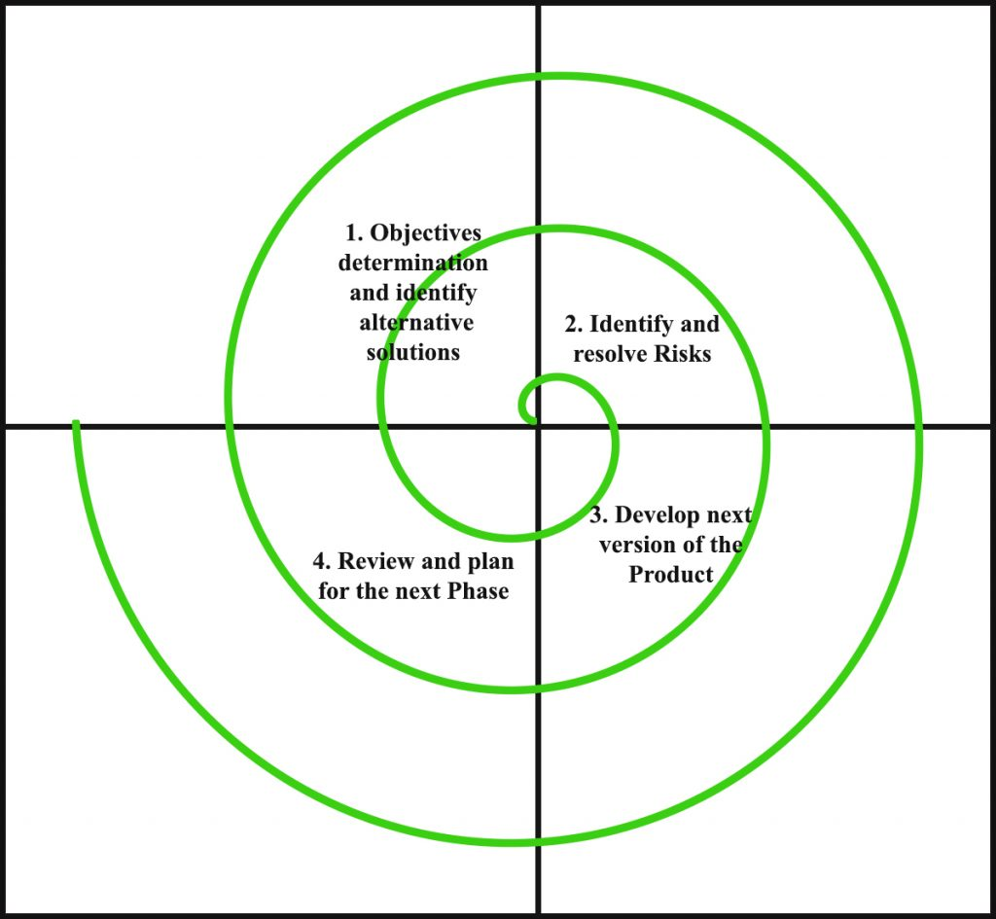
Review and plan for the next Phase: In the fourth quadrant, the Customers evaluate the so far developed version of the software. In the end, planning for the next phase is started.

Slide 5
MERITS
Risk Managing Feature
Suitable for more extensive projects
Docile in terms of Requirements
Client Satisfaction
Early Estimation of Cost

Slide 6
DMERITS
Difficulty
Expensive
Too much dependability on Risk Analysis:
Difficulty in time management
Complicated in terms of user-friendliness:
Maintenance of prototypes

Slide 7
When to use?
A Spiral model in software engineering is used when project is large.
When releases are required to be frequent, spiral methodology is used.
When risk and costs evaluation is important.
When requirements are unclear and complex
Spiral methodology is useful for medium to high-risk projects.

Slide 8


